Slide 1
Files: Reading and Writing.
Week 9 | Lecture 2 (9.2)

Slide 2
This Week’s Content
Lecture 9.1
Advanced Functions and Aliasing
Lecture 9.2
Files: Reading and Writing
Lecture 9.3
Design Problem! Real Estate

Slide 3


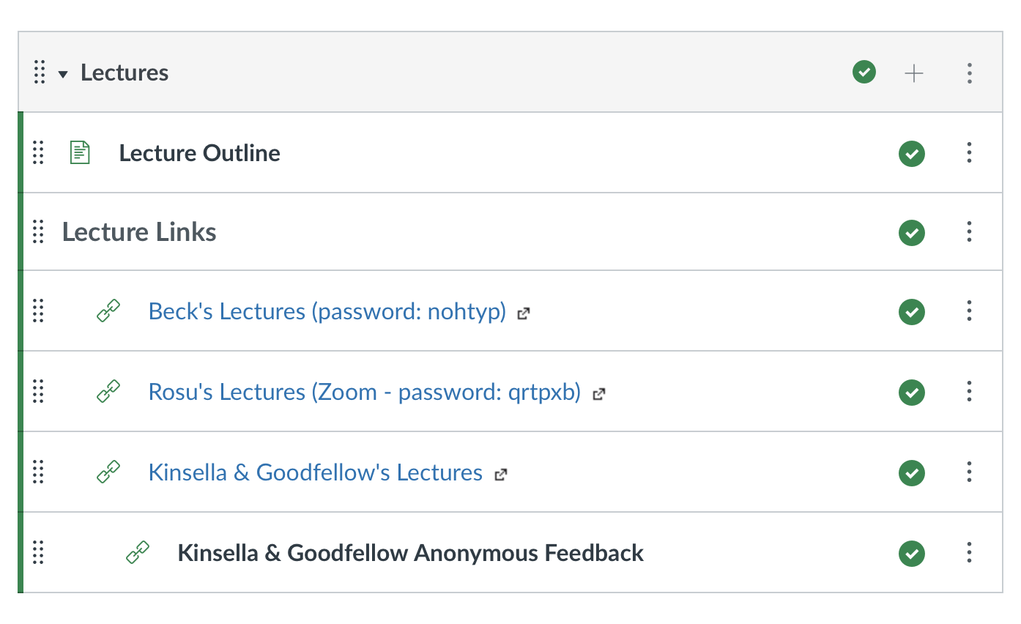


All The Feedback!
Katia
Seb
Joseph
Ben

Slide 4


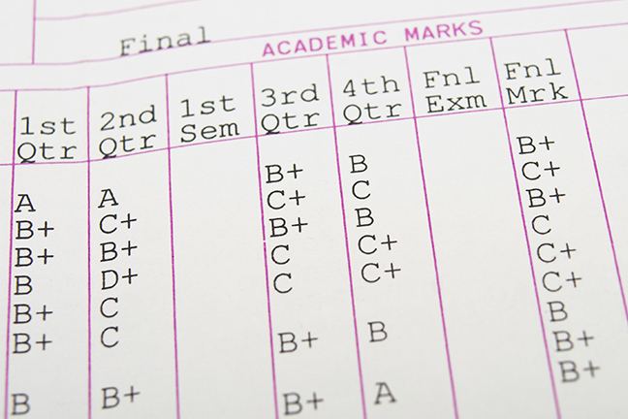
Motivating Examples
Everything we’ve done so far is essentially deleted when our program ends
What if we wanted to store information?

Slide 5


Why work with files?
While a program is running, its data is stored in random access memory (RAM). RAM is fast and inexpensive, but it is also volatile, which means that when the program ends data in RAM disappears.
To make data available the next time the program is started, it has to be written to a non-volatile storage medium, such a hard drive, USB drive, or CD-R.

Slide 6

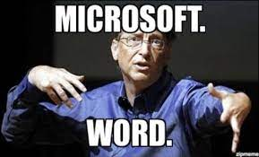
Why work with files?
Data on non-volatile storage media are stored in named locations on the media called files.
By reading and writing files, programs can save information between program runs.

Slide 7

It’s like working with a notebook!
A file must be opened.
When you are done, it has to be closed.
While the file is open, it can either be read from or written to.
Like a bookmark, the file keeps track of where you are reading to or writing from.
You can read the whole file in its natural order or you can skip around

Slide 8
Opening a File
Python has a built-in function open that creates a file object with a connection between the file information on the disk and the program.
The general form for opening a file is:
where mode is 'r' (to open for reading), 'w' (to open for writing), or 'a' (to open for appending to what is already in the file).
filename is an external storage location.
open(filename, mode)

Slide 9
Writing to a File
The following statement opens the file test.txt in write mode ‘w’.
If there is no file named "test.txt" on the disk, it will be created. If there already is one, it will be replaced by the file we are writing.
The file will be assigned to the object myfile that knows how to get information from the file.
myfile = open(‘test.txt’, ‘w’)

Slide 10
Writing to a File
To write something we need to use the write method as shown:
The write method does not attach a new line character by default.
Every time we use myfile.write() a string is added to file “test.txt” where we left off.
myfile.write(‘CATS!…’)
myfile.write(‘\n’)
myfile.write(‘I <3 my second line… \n’)

Slide 11
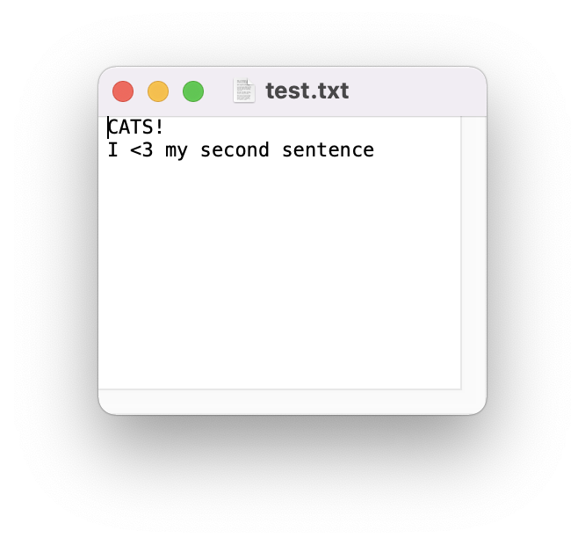
myfile = open(‘test.txt’, ‘w’)
myfile.write(‘CATS!…’)
myfile.write(‘\n’)
myfile.write(‘I <3 my second line… \n’)

Slide 12
Closing a File
Once you have finished with the file, you need to close it:
This tells the system that we are done writing and makes the disk file available for reading or writing by other programs (or by our own program).
myfile.close()

Slide 13
Let’s Code!
Let’s take a look at how this works in Python!
Writing to your first file
Figure out where your files are getting saved!
Current working directory
Try playing with “w” and “a” mode!
Breakout Session!
Click Link:
1. Write to your first file!

Slide 14

CLOSE THE FILE!
myfile.close()
Always close a file that you’ve opened!
Many changes don’t occur until after the file is closed
Leaving open is a waste of a computer’s resources
Slows down program, uses more space in RAM, impacts performance
Other files may treat the file as “open” and won’t be able to read the file
Could run into limits about how many files you have open
Not #cleancode

Slide 15

The ”Writing to Files” Recipe
# create a file
myfile = open("grades.txt", "w")
# write to a file
myfile.write(’string’)
# close the file
myfile.close()
go together

Slide 16
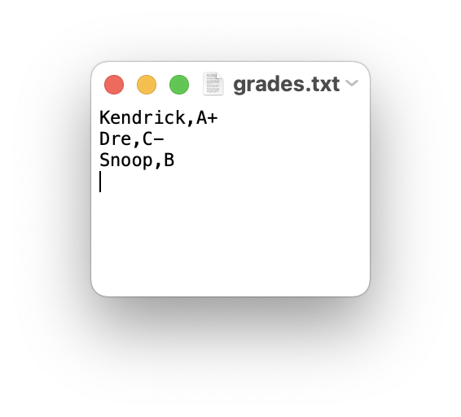
Example: Writing to Files
How would we store a dictionary data structure in a file?
students = {‘Kendrick': 'A+', ‘Dre': 'C-', ‘Snoop': 'B'}
# create a file
myfile = open("grades.txt", "w")
# store dictionary items to the file
for student in students:
myfile.write(student + ',' + students[student] + '\n')
# close the file
myfile.close()

Slide 17
Let’s Code!
Let’s take a look at how this works in Python!
Using a loop to write a dictionary to file
Beakout Session!
Click Link:
2. Writing a dictionary to file

Slide 18


Writing and Reading
Can be any name!
myfile = open(‘test.txt’, ‘w’)
'w’ OR ‘a’
myfile = open(‘test.txt’, ‘a’)
myfile.write(‘CATS!…’)

Slide 19
Different ways of Reading a File
Reading a file is similar to writing a file. First we need to open a file for reading (“r”):
If file doesn’t exist? ERROR
Then to read a file we apply one of the following approaches which take advantage of various read methods:
The read approach
The readline approach
The for line in file approach
The readlines approach
myfile = open(‘test.txt’, ‘r’)
No correct approach!
Multiple methods to help with contexts and purposes

Slide 20
Different ways of Reading a File
Approach | Code | When to use it
The read approach | myfile = open(filename, 'r') contents = myfile.read() myfile.close() | When you want to read the whole file at once and use it as a single string.
The readline approach | myfile = open(filename, 'r') contents = '' line = myfile.readline() while line != '': contents += line line = myfile.readline() myfile.close() | When you want to process only part of a file. Each time through the loop line contains one line of the file.
The for line in file approach | myfile = open(filename, 'r') contents = '' for line in myfile: contents += line myfile.close() | When you want to process every line in the file one at a time.
The readlines approach | myfile = open(filename, 'r') lines = myfile.readlines() myfile.close() | When you want to examine each line of a file by index.

Slide 21
Example: Reading a File
Now that we have a file "grades.txt" stored. How would we go about retrieving and storing the data into a dictionary?
students = {}
myfile = open("grades.txt", "r")
# read each line of the file
for line in myfile:
# find indices for slicing each line
ind1 = line.find(',')
ind2 = line.find('\\')
name = line[:ind1]
grade = line[ind1+1:ind2]
students[name] = grade
myfile.close()
grades.txt
Kendrick,A+
Dre,C-
Snoop,B
>>> students
{‘Kendrick’: A+, ‘Dre': 'C-', ‘Snoop': ‘B'}

Slide 22
Let’s Code!
Let’s take a look at how this works in Python!
Different read approaches
read()
readline()
for line in file
readlines()
Open your notebook
Click Link:
3. Reading Files

Slide 23
The with Statement
Every call on function open should have an accompanying call on the method close.
Python provides a statement with, which automatically closes the file when the end of with block is reached.
The general form of a with statement is as follows:
with open(filename, mode) as variable:
body

Slide 24
Example: with Statement
Modifying the previous example, of reading a file into a dictionary, to use the with statement.
students = {}
myfile = open("grades.txt", "r")
with open("grades.txt", "r") as myfile:
# read each line of the file
for line in myfile:
ind1 = line.find(',')
ind2 = line.find('\\')
name = line[:ind1]
grade = line[ind1+1:ind2]
students[name] = grade
myfile.close()

Slide 25
Let’s Code!
Let’s take a look at how this works in Python!
Opening and closing files with the with statement
Beakout Session!
Click Link:
3. The with statement

Slide 26

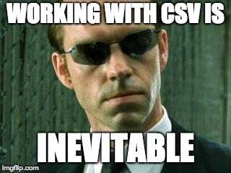
Comma Separated Values files
We use them often in Excel, and other spreadsheet software
Remember our old friend MS Excel? They work with Python too…

Slide 27
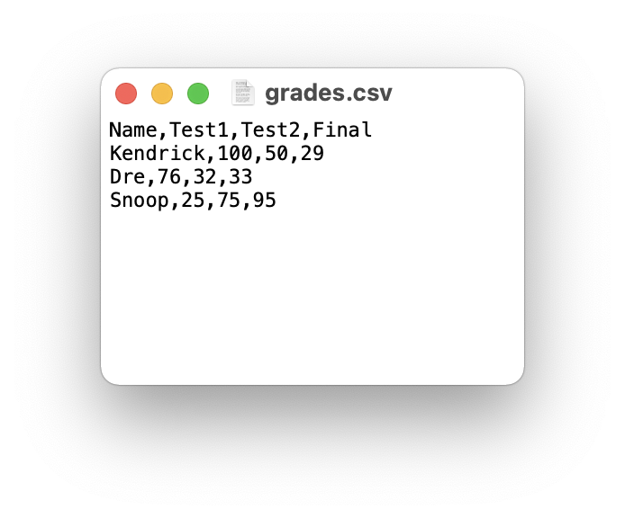
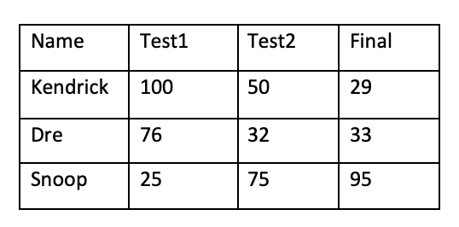
CSV Files
Text data is commonly organized in a spreadsheet format using columns and rows.
A common way to do this is to use a comma-separated value (CSV) file format that uses commas to separate data items, called fields.

Slide 28
Example: Opening a CSV File
Let’s see what happens when we try to read the CSV file, 'grades.csv' using the file reading techniques discussed earlier.
How can we use this to obtain column and row information?
with open('grades.csv', 'r') as file:
contents = file.read()
>>> contents
'Name,Test1,Test2,Final\nKendrick,100,50,29\nDre,76,32,33\nSnoop,25,75,95\n'

Slide 29

Reading CSV Files
The CSV module is a powerful solution developed for working with CSV files.
Reading of CSV files is done using the CSV reader. You can construct a reader object using csv.reader() which takes the file object as input.
The reader object can be used to iterate through the contents of the CSV file, similarly to how a file object was used to iterate through the contents in a text file.

Slide 30
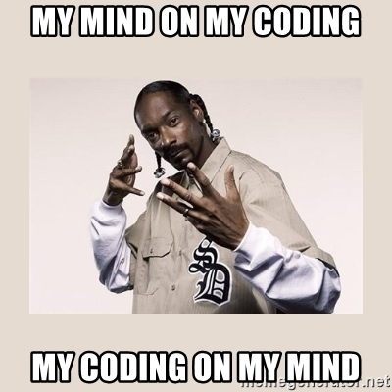
Example: Reading a CSV File (open)
Read each row of a CSV file using open
import csv
csvfile = open("grades.csv", "r")
grades_reader = csv.reader(csvfile)
row_num = 1
for row in grades_reader:
print('Row #', row_num, ':', row)
row_num += 1
csvfile.close()
Row # 1 : ['Name', 'Test1', 'Test2', 'Final']
Row # 2 : [‘Kendrick', '100', '50', '29']
Row # 3 : [‘Dre', '76', '32', '33']
Row # 4 : [‘Snoop', '25', '75', '95']

Slide 31
Example: Reading a CSV File (with)
Read each row of a CSV file using with
import csv
with open('grades.csv', 'r') as csvfile:
grades_reader = csv.reader(csvfile)
row_num = 1
for row in grades_reader:
print('Row #', row_num, ':', row)
row_num += 1
Row # 1 : ['Name', 'Test1', 'Test2', 'Final']
Row # 2 : [‘Kendrick', '100', '50', '29']
Row # 3 : [‘Dre', '76', '32', '33']
Row # 4 : [‘Snoop', '25', '75', '95']

Slide 32
Writing CSV Files
To write to the file we would first need to create a CSV writer object, csv.writer(), which similar to how we made a, CSV reader object.
Once the CSV writer object is created, we can use the writerow() method to populate it with data.
The writerow()method can only write a single row to the file at a time.

Slide 33
Example: CSV Files
In the previous grade example there were a few marking errors on the final exam and both John and Mark should have received a higher grade. Update the grades using the CSV writerow()method.
import csv
grades = [['Name', 'Test1', 'Test2', 'Final'],
[‘Kendrick', '100', '50', '69'],
[‘Dre', '76', '32', '53'],
[‘Snoop', '25', '75', '95']]
with open('grades_new.csv', 'w') as csvfile:
grades_writer = csv.writer(csvfile)
for row in grades:
grades_writer.writerow(row)

Slide 34
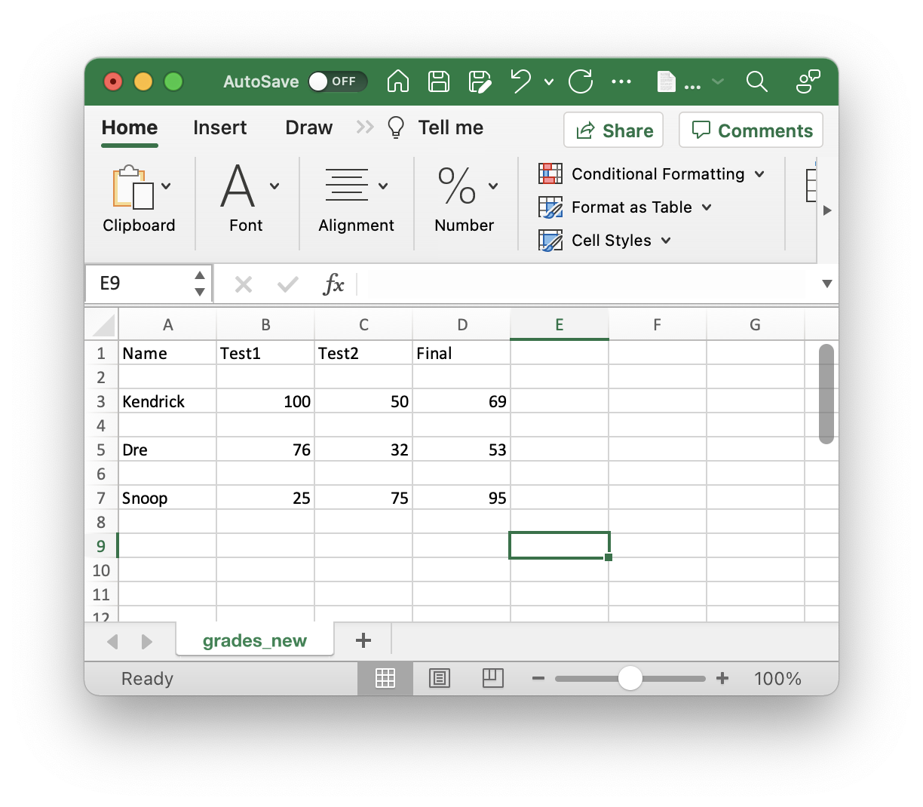
Opening CSV File in Excel
In the previous example we created a CSV file which can be opened in any commonly used spreadsheet software (e.g. Excel).
In some cases a formatting error may occur, probably due to the difference between newlines and carriage returns in Windows vs. Mac/Linux.
To correct this error in formatting, we will need to prevent the new line from forming. Add the parameter newline='', and that should resolve the problem.
with open('grades_new.csv', 'w', newline='') as csvfile:

Slide 35
Let’s Code!
Let’s take a look at how this works in Python!
Reading and Writing to CSV Files
Parsing through CSV Files
Open your notebook
Click Link:
4. CSV Files

Slide 36
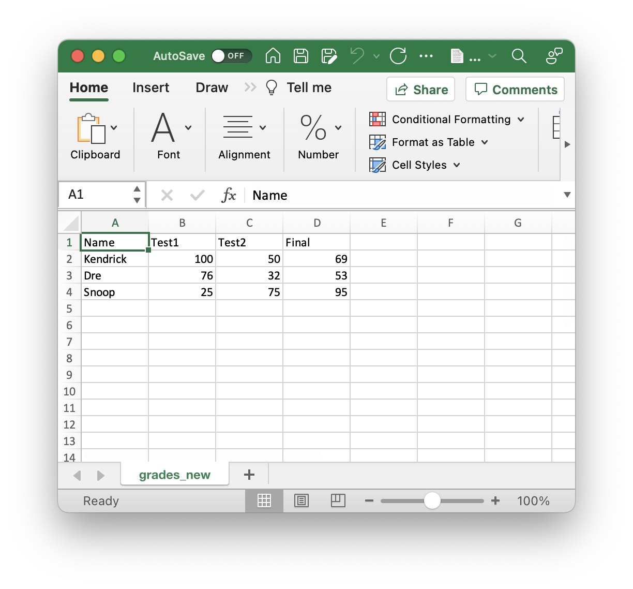
Summary: Reading Files
Requirement: “grades.csv”
################################
# reading a file using standard approach
################################
# open communication to a file (to read)
myfile = open('grades.csv', 'r')
# read from file
L = myfile.readlines()
for row in L:
print(row, end = '')
myfile.close()
############################
# reading a file using CSV Module
############################
import csv
# open communication to a file (to read)
myfile = open('grades.csv', 'r')
# read from file
csv_reader = csv.reader(myfile)
for row in csv_reader:
print(row)
myfile.close()
Requires find() method to obtain data!

Slide 37
Summary: Writing Files
Requirement: grades needs to be defined
grades = [['Name', 'Test1', 'Test2', 'Final'],
[‘Kendrick', '100', '50', '69'],
[‘Dre', '76', '32', '53'],
[‘Snoop', '25', '75', '95']]
#################################
#writing to a file using standard approach
#################################
# open communication to a file (to write)
myfile = open('new_grades.csv', 'w')
# write to file
for row in grades:
for col in row:
myfile.write(col + ',')
myfile.write('\n')
myfile.close()
#############################
#writing to a file using CSV Module
#############################
import csv
# open communication to a file (to write)
myfile = open('new_grades.csv', 'w')
# write to file
grades_writer = csv.writer(myfile)
for row in grades:
grades_writer.writerow(row)
myfile.close()

Slide 38
Files: Reading and Writing.
Week 9 | Lecture 2 (9.2)

